Slide 1
DPM Extended
Andrew Kharma
Senior Validation Engineer
6/22/2023

Slide 2
Support Disclaimer
This slide deck contains new extensions and customizations that are not officially supported by PTC.
Extensions are net new features that won’t affect the existing application
Customizations are modifications to the logic or data displayed of the existing application
Feature | Type | Officially Supported
MMM | Customization | No
Time Loss Pareto Report | Extension | No
Shift Summary Report | Extension | No
Summary Dashboard Report | Extension | No
Status Timeline/Manual Availability Events | Customization | No
New Scorecard Metrics | Customization | No

Slide 3

Overall Strategy is to Make MMM as Upgradeable as possible
Using BB strategies to override TWX and SQL code where needed
No direct DB Schema changes. Using new tables or AP tables.
Minimal changes to the UI

Slide 4
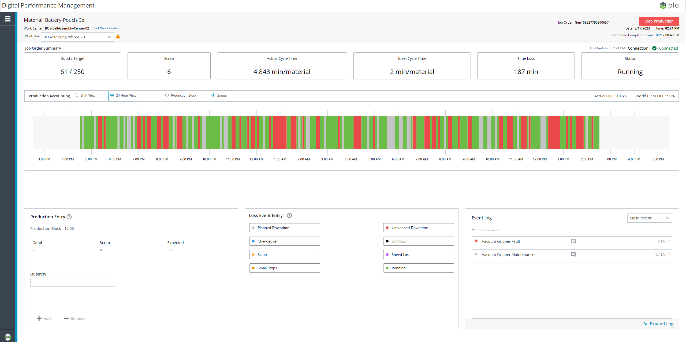
Operator Dashboard
Added dropdown to allow for work unit selection
Job orders can be started and stopped on each work unit
Production and Loss Events can be created/edited for each work unit
Status Timeline displays historical up and down time for each work unit
Operator can now enter Start and End Time for down time events
Operator can now edit automation events to change reason or work unit causing event

Slide 5
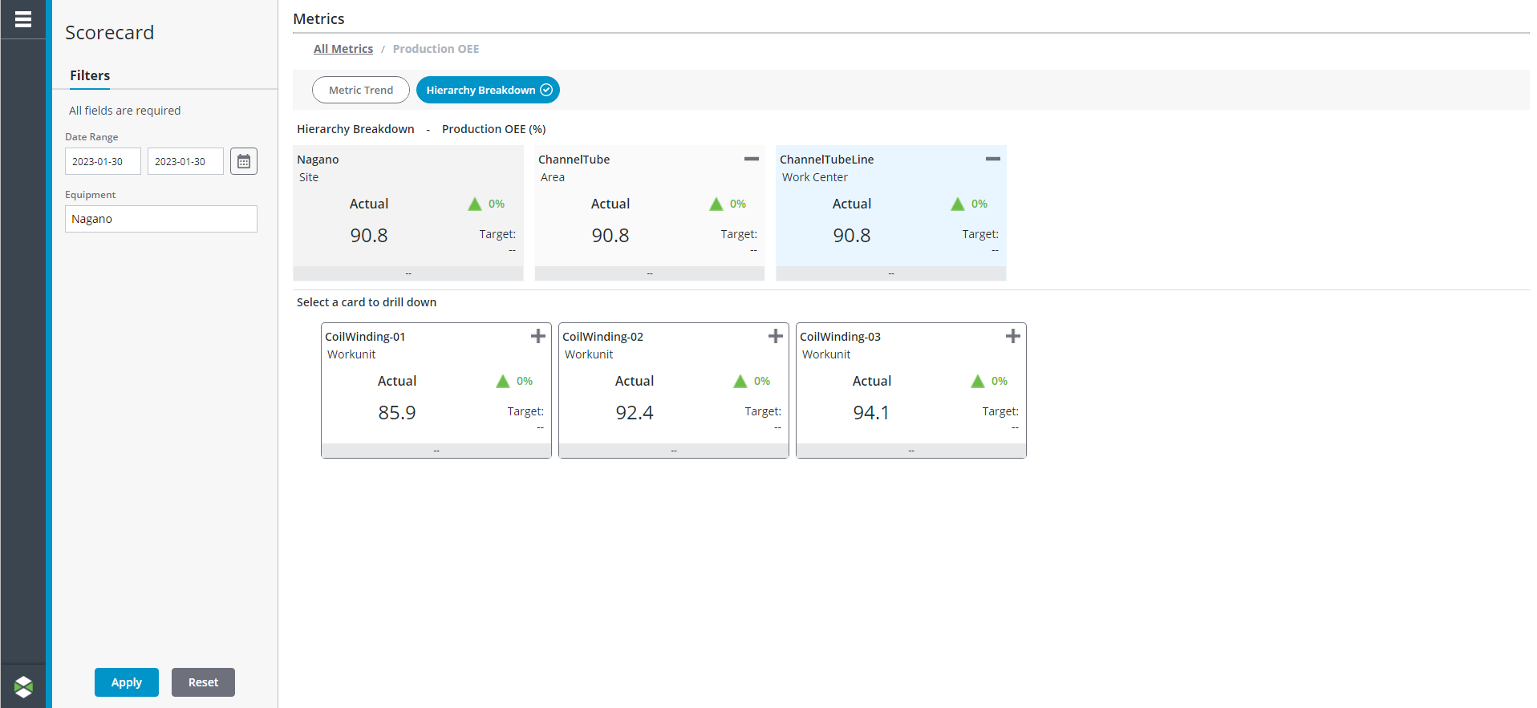
Scorecard
Allows the user to drill down to view work unit data
New metrics added including APQ and Loss Percentages

Slide 6
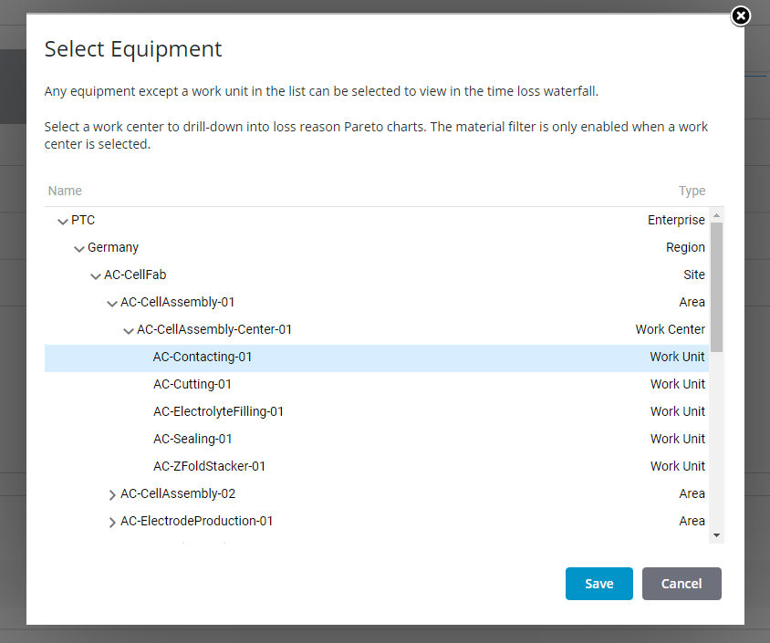
Waterfall
Allows the user to drill down to view work unit data
Work Center data and above is based on pacemaker data only
Multiple pacemakers’ data is averaged together to form work center data

Slide 7
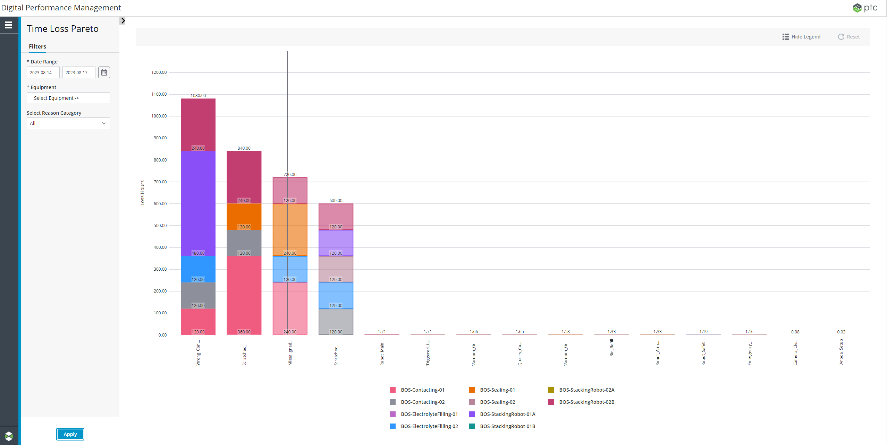
New Report – Time Loss Pareto
Displays Most Common Loss Reasons
Breaks down loss reason data by work unit
Able to compare across any level of Asset Hierarchy

Slide 8
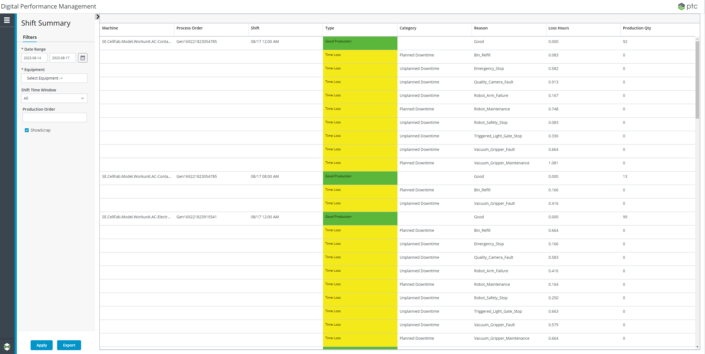
New Report – Shift Summary
Displays breakdown of loss reasons grouped by work unit, job order, and shift

Slide 9
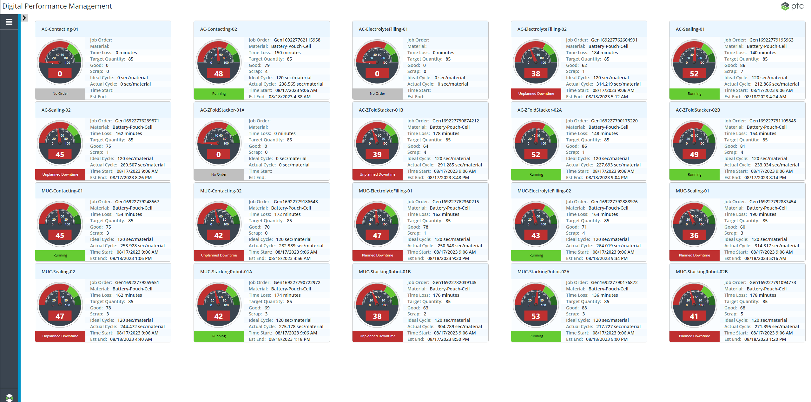
New Report – Summary Dashboard
Provides a dashboard that shows Current Status and Job order information for selected work units

Slide 10
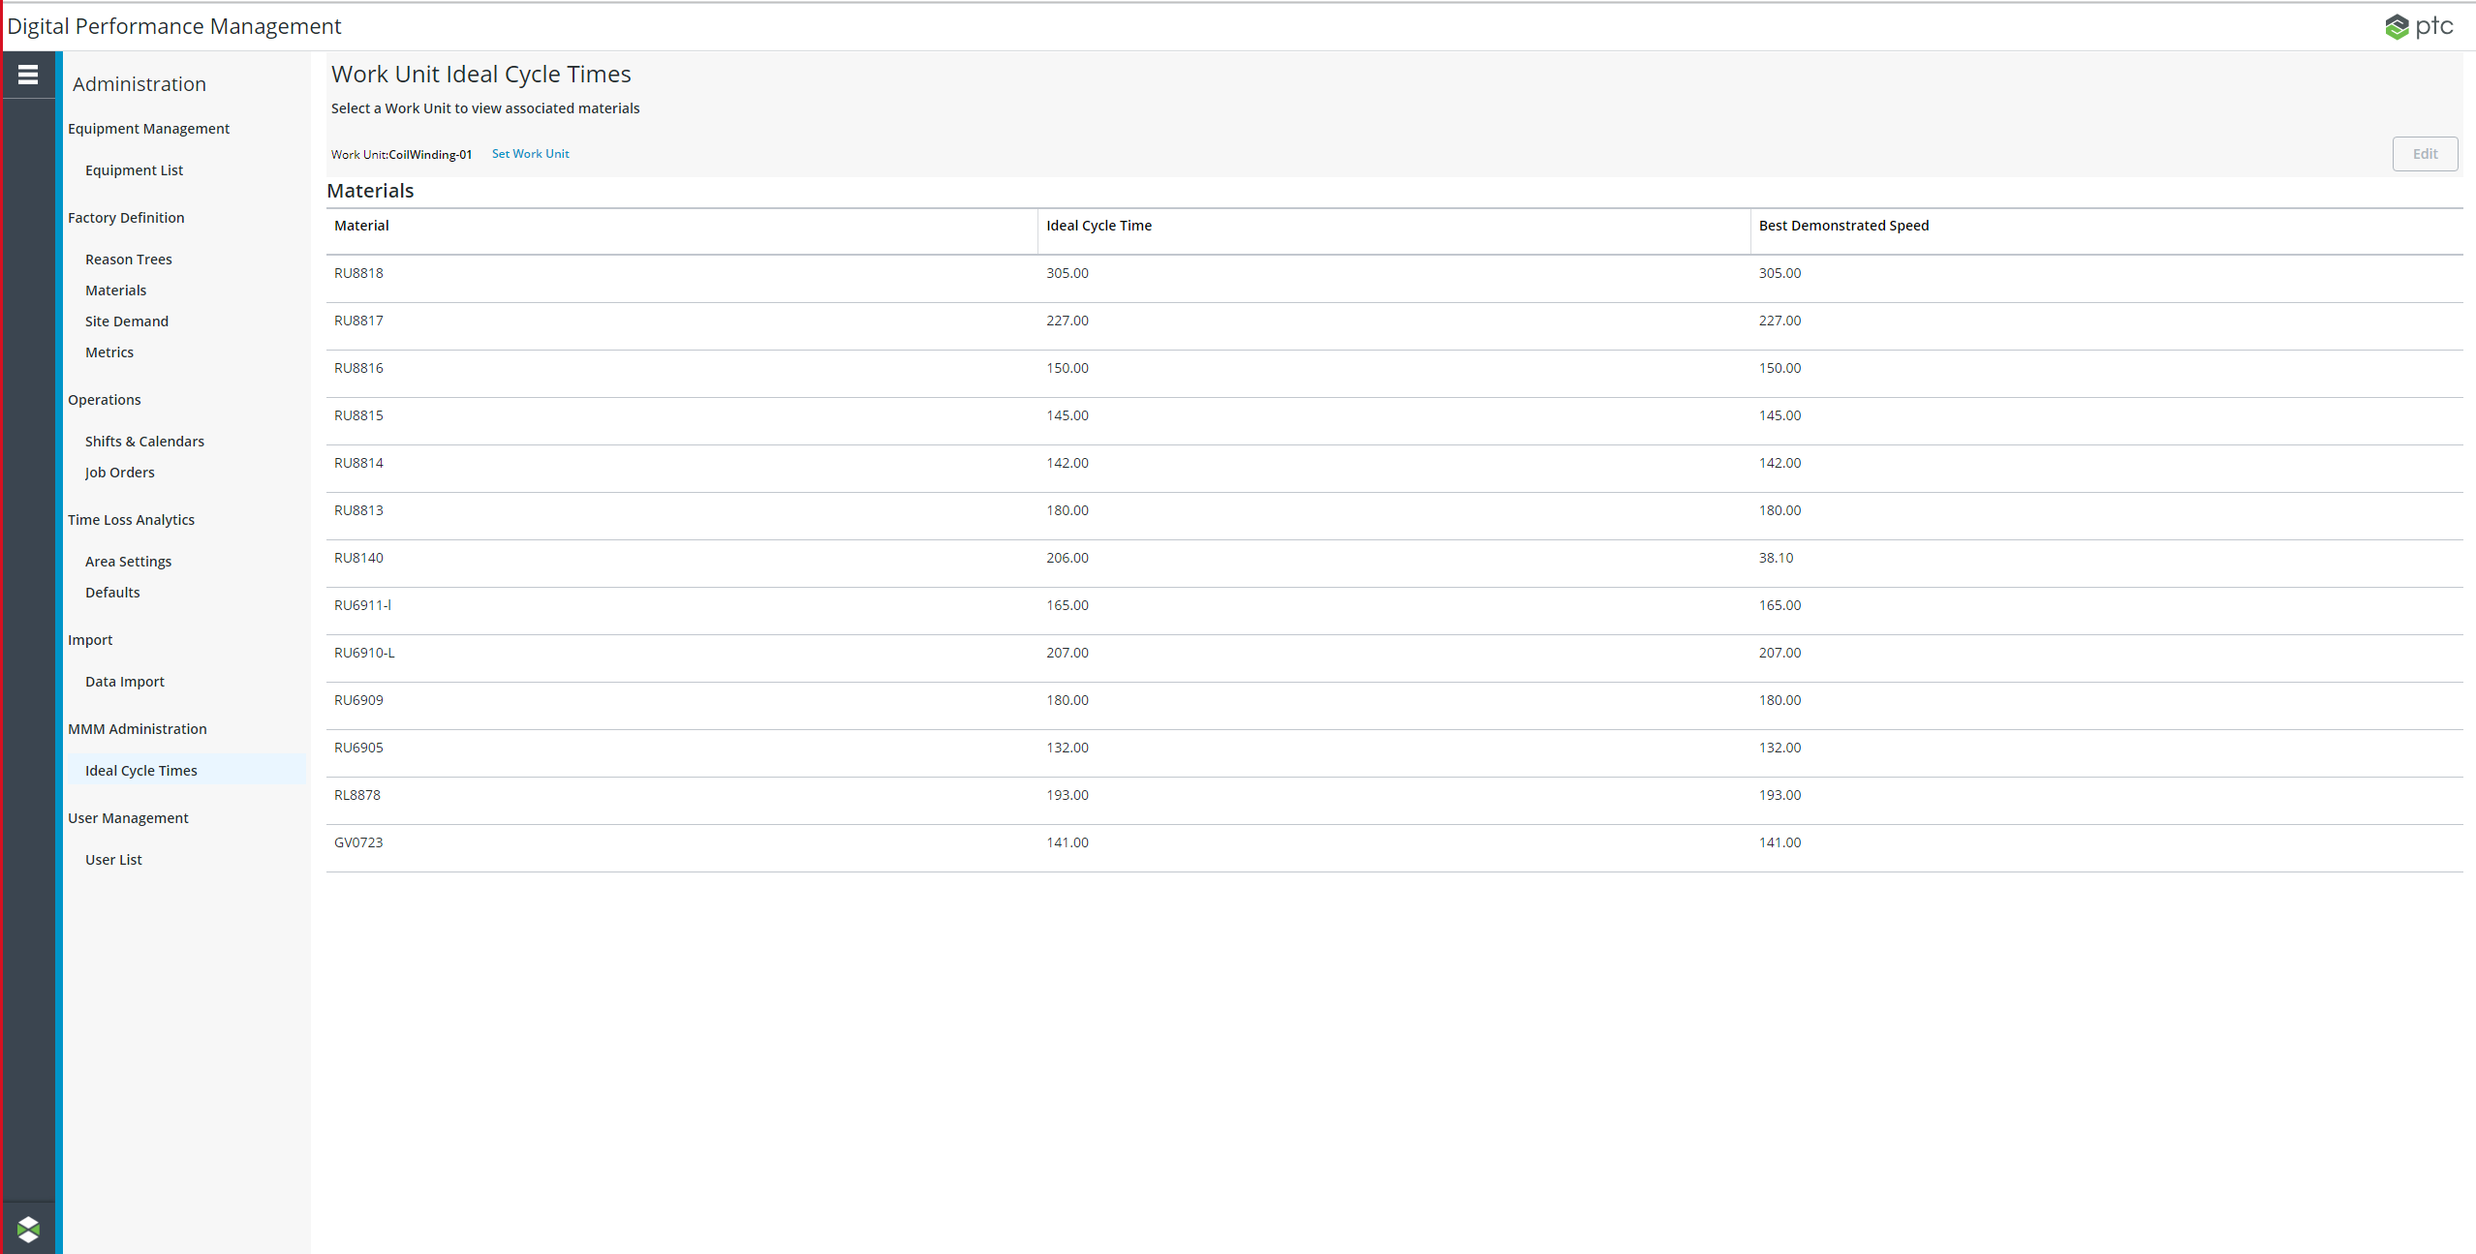
New Administration Screen
A new UI to allow users to modify the ideal cycle times of materials at the work unit level

Slide 11
Configuration
All functionalities are configurable so that an admin can toggle various features on/off

